Slide 1
Clustering Colleges Based on Neighbourhood Similarities
Deepratna Awale

Slide 2
Introduction
Millions of students pursue master’s as higher education.
They have their own expectations from colleges.
For Domestic students its comfort zone, for international its security.
What if you could choose other colleges based on your college of choice?
You can, by clustering them!
My main target audience is students. Specifically, students like me, dreaming to pursue a Master’s in ‘Computer Science & Information Technology’ in Data Science / Analytics

Slide 3
Data requirement and acquisition
We are using www.mastersportal.com to mine the data. We are searching for Canada, United States, United Kingdom based colleges/ universities that provide full time Master's Degree Programme in the field of Computer Science and IT
Required Data:
College Id
College Name
College Fees
Address
Geospatial Coordinates

Slide 4
There are two types of data that we need:
College Details (JSON Data): Web Scraping
Geospatial Coordinates (JSON Data): Google Places API
We’ll be collecting college data in a single JSON file by appending to it all the search results that we obtained.
We join the main data frame and venues data frame to form a complete dataset. We keep only the required columns:
College Id: ‘id’
College Name: ‘college_name’
College Fees: ‘fees’
Address: ‘City’, ‘Area’, ‘Country’

Slide 5
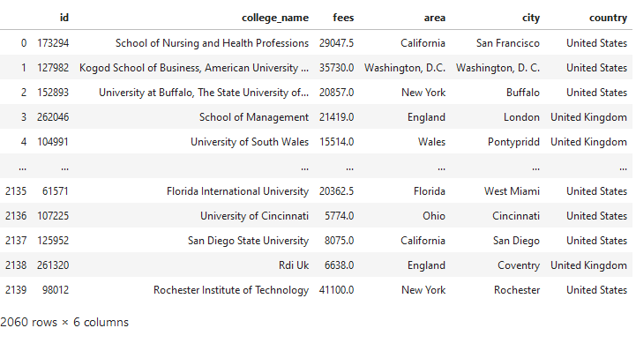
The data frame looked like this after cleaning:
Table 1: Clean data frame after normalizing college data

Slide 6
To give tuition fees a uniform scale, we convert all credit-based fees to yearly fees.
The formula to convert (approximately) credit based tuition fee to annual tuition fee:
df.loc[df['tuition_fee.unit'] == 'credit', 'tuition_fee.value'] = (df['tuition_fee.value']*45)/2
Note: This causes discrepancies in data which we’ll solve later. Also, the number of credit-based fees were too few compared to annual fees, thus there is no significant impact

Slide 7
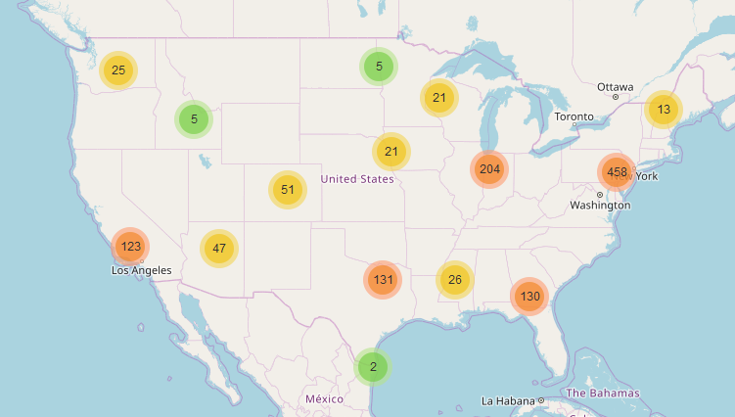
EXPLORATORY DATA ANALYSIS Spatial Data Analysis
I formed three more data frames representing colleges in USA, UK and Canada separately.
United States of America

Slide 8
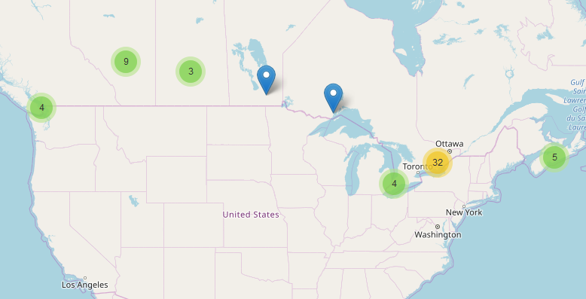
Canada

Slide 9
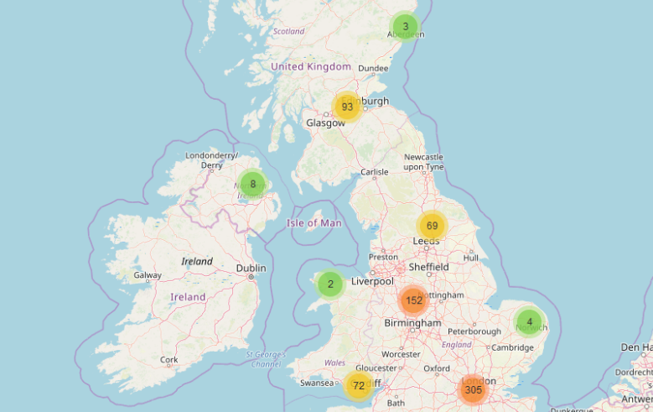
United Kingdoms

Slide 10
USA has a large number of colleges to the east. Also it has over 1200, the most number of colleges among all the countries.
Canada has negligible colleges compared to USA and UK. It has only 52 colleges.
UK has the best distribution of college. It has over 700 colleges.

Slide 11
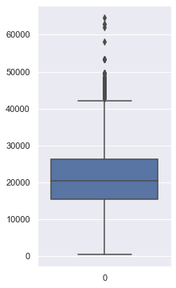
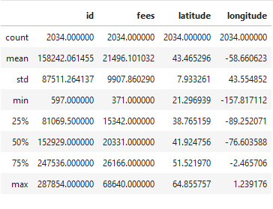
EXPLORATORY DATA ANALYSIS Numerical Data Analysis
The box plot and the table show us the following:
25% colleges have fees up to 15342.
50% colleges have fees up to 20331.
75% colleges have fees up to 26166.
The highest reported tuition fee is 68640.

Slide 12
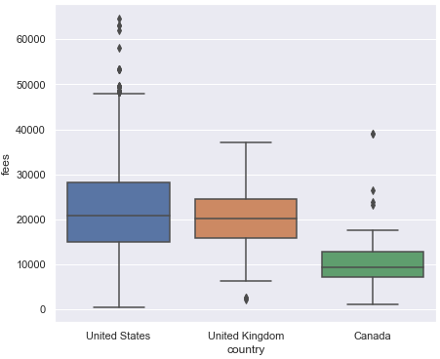
Canadian colleges are best when looking for similar low fees colleges when holding money as a criterion.
Similarly, UK would be a preferred choice when choosing mid to high fees colleges when compared to USA when holding money as a criterion.
It is obvious, but let me specifically point out, USA has the highest fees in all 3 nations.
Figure 7: Tuition fee comparison of countries

Slide 13
Clustering
After acquisition of geospatial coordinates and cleaning the dataset, its time to explore each college neighbourhood to cluster them.
We’ll make a data frame where colleges are grouped along with the dummy columns that gives us a data frame of dimensions 629x387.
I’ve successfully clustered the college neighbourhood into the following categories:
American Eats
Exotic Eats
Tour/ Outgoing
Night Life (Pub) and Fitness
Art Prone/ Mature Audience

Slide 14
Future Possibilities
By clustering such colleges, we can sort colleges according to our whim by putting constraints like, want café or want gym.
This will help us shortlist colleges for the application process.
We can predict what kind shop should be opened near a college or where should we rent a place to get the most benefit.

